Slide 1

TRAVEL MANAGEMENT SYSTEM
Student name: JASPREET KAUR
Student id: 102146004

Slide 2
Introduction
The project that replaces the paper-based one aims to embed the TMS to modernize the Solent Trips operations.
Rather, it will pull all trip-related work together, improve the staff-traveler's communication, and simplify the trip management processes in order to overcome the challenges of travel management by the company.
For the trip coordinator, manager, and administrators, as well as the base trip leg, the trip, and the traveler management should be one of the primary functional requirements.
Notes:
TMS strives to cut paperwork up to the extreme, increasing productivity, and thus, coming up with an easy-to-follow procedure, for both staff and travelers by taking advantage of Python as well as following the best practices for software development. The goal of the project at last is to help in solving our customers’ needs and also update our operating standards to the present ones.

Slide 3
System Architecture
The system architecture consists of three main parts: Traveller Management, Trip Description, and Login & Registration functionalities.
These features make the use of the hotel booking application very convenient for consumers. Authentication and new account creating are to be performed in the Login & Registration component.
Members can begin the session by either creating an account or logging in with their login information. Users will be granted access to the system's functionalities only and they will be able to do that when they successfully log in.
Notes:
The users would be able to adapt to their trips and go to different destinations using the Trip Description component. Travelers' freedom of choice in terms of things such as what places of interest appeal to them, planning whether it is a solitary trip or not, as well as the sort of hospitality they want makes their journey more enjoyable. This module is designed to work in tandem with any third-party system, by capturing relevant trip information and resources. Users have an option of both customizing their travel preferences and their personal data with the help of the Traveller Management component.

Slide 4
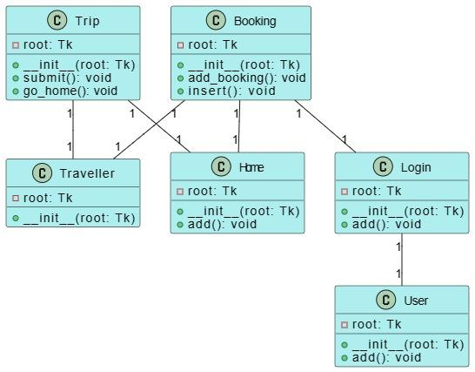
UML Diagrams
The given figure shows the travel management system (TMS) class diagram which illustrates how components of the system are interacting and exchanging.
A number of important classes make up the system: Booking, Home, Login, User, Trip, and Traveler.
All courses possess the specified operations that are relevant to different system components.

Slide 5
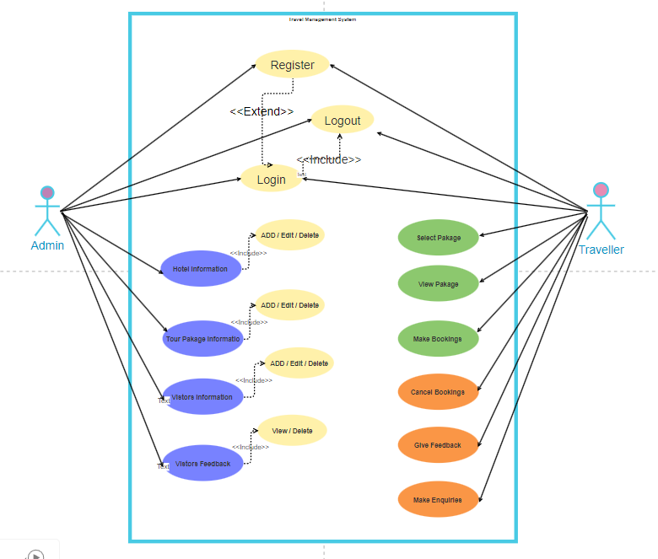
Use case diagram
A use case diagram for a travel management system illustrates various ways actors of the system are involved.
Use cases are the features or services that the system offers, while actors represent participants who use or integrate with the system.
"T" and "System User" are considered to be the main actors in this travel management system.
The System Users can be either staff members or administrators.

Slide 6
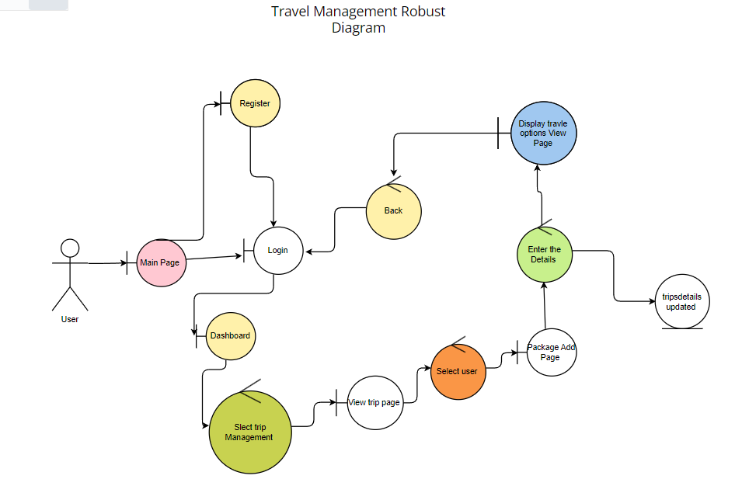
Robustness diagram
The system provides these use cases to meet the needs of actors which themselves are "Make bookings," "Update Traveller Info," "Manage Trips," and "Search Trip Details. "
Visualization of the system's functional requirements and interaction among the various components is carried out using use case diagram in the use case diagram.
Notes:
TravellerController object is configured to access traveller data, i.e., to get travellers' information as well as modify it, through use of the TravellerModel object that manages traveller login, logout, and registration activities. Likewise, in addition to the BookingController and TripController which handle actions pertaining to bookings and trips by calling their models, there is a PaymentController that deals with the payments. Specific functions of the system and how they are interconnected are seen in this diagram thus the user will find it easier to grasp its needs and how it behaves.

Slide 7
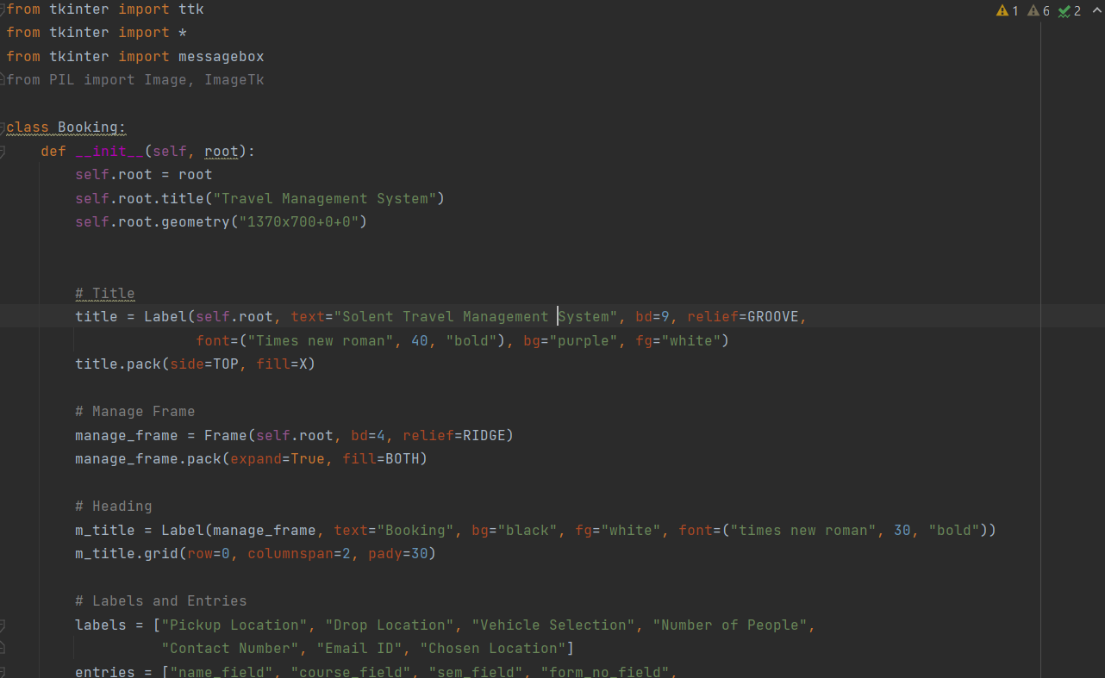
Software Development Process
This program involves Tkinter to define a class called Booking in a Travel Management Systems hardware.
The pops-up interface section of a GUI features booking forms, including destination selection, car selection, and contact detail requirements, pickup and drop locations.
Moreover, it has combobox that can select a mode of transport. For instance, the class contains methods to display message boxes conveying the fact that features to be incorporated at addition and insertion of booking data.
Notes:
It also goes through suggesting the possible travel options and showing a button that can be used for the submission of choices. Once received, it leads to the initiation of a sub-process to run an additional Python script, most likely featuring the traveler login process. This code in general develops the user interface which users can use to navigate through the various system functionalities.

Slide 8
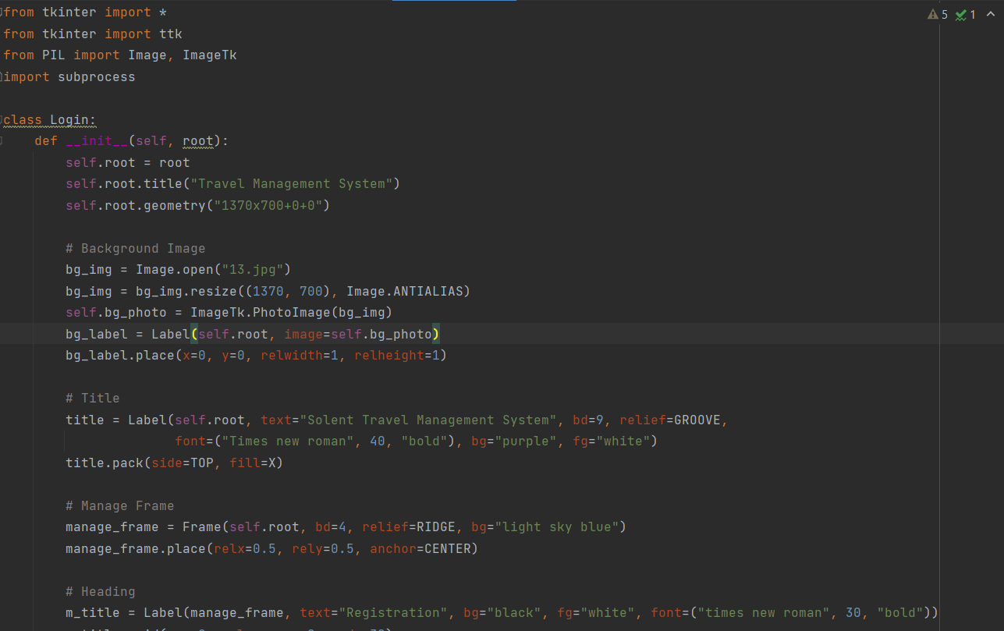
registration class
This code the Tkinter syntax creates an interface used for travel management system registration.
Here it is a frame with the title and picture heading.
It uses textboxes and combo boxes for the purpose of containing fields where the details of the tourist like name, address, contact, and ID are being included inside manage frames.
On the submission of the button, there is a good chance of another Python script in the subprocess being launched mostly for the processing of the registration data.
Notes:
On the submission of the button, there is a good chance of another Python script in the subprocess being launched mostly for the processing of the registration data. The code, therefore, allows the user interface whereby travelers have to log in and register their data before engaging with the system.

Slide 9
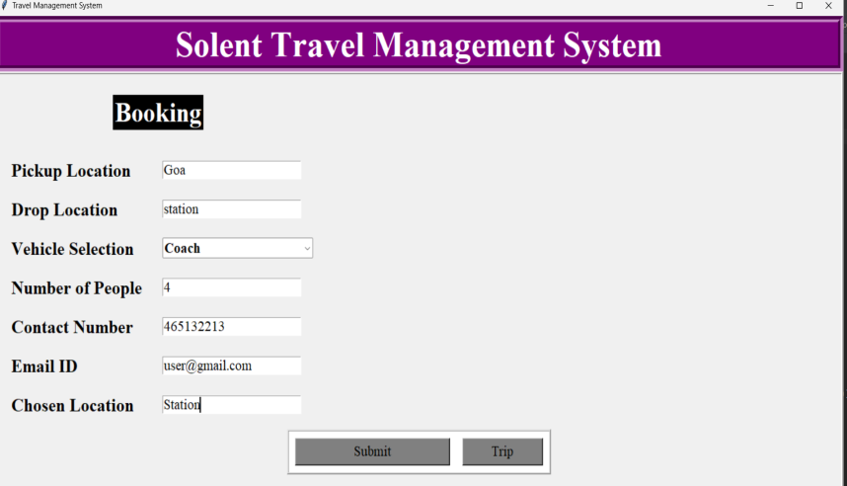
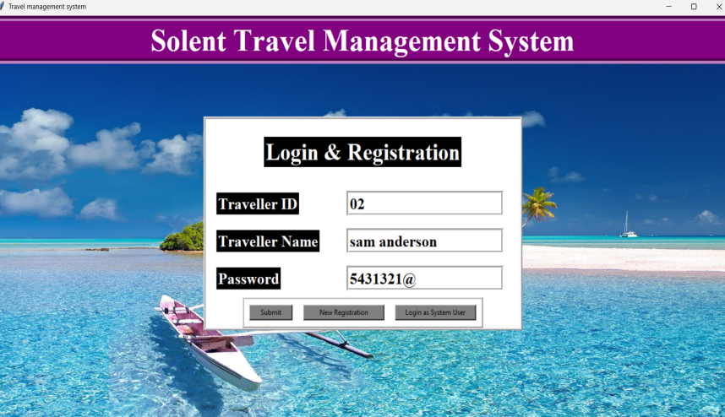
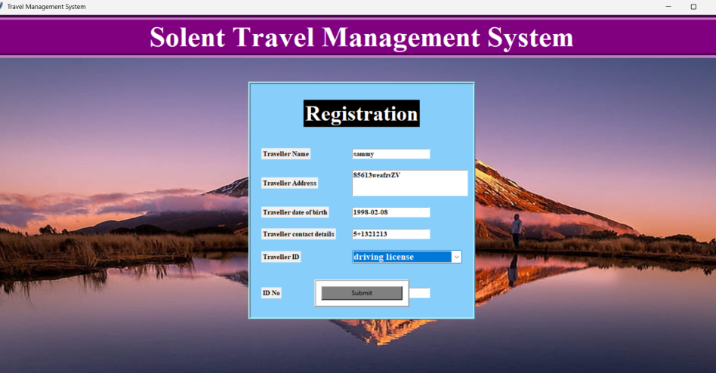
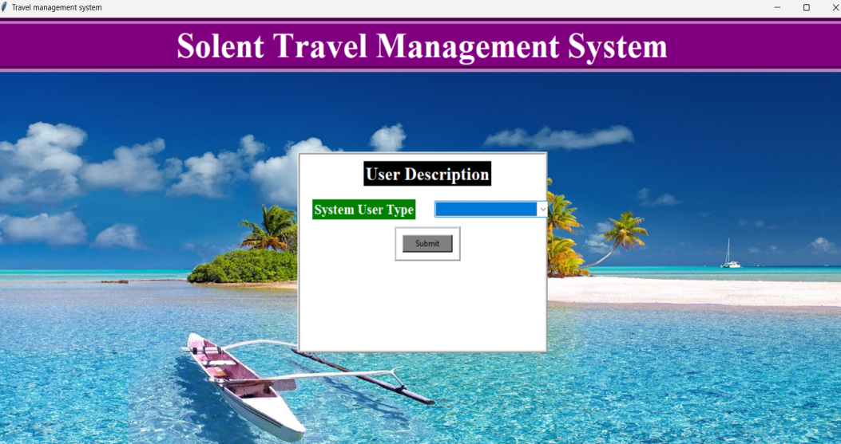
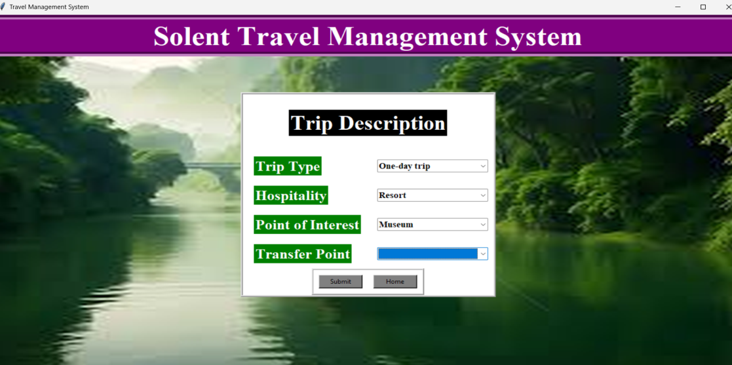
Project Implementation
Notes:
These options are embedded with a manage frame. They are found inside a webpage that includes a combo box. It also goes through suggesting the possible travel options and showing a button that can be used for the submission of choices. Once received, it leads to the initiation of a sub-process to run an additional Python script, most likely featuring the traveler login process. This code in general develops the user interface which users can use to navigate through the various system functionalities.

Slide 10
Conclusion
In summary, the Travel Management System (TMS) takes a holistic set of steps to ensure that the business runs the day to day managerial activities involved in travel.
By employing Tkinter, it provides a user interface that allows the passengers to sign-up and book trip schedules with ease.
Users can easily process a lot of travel-related tasks thanks to a broad range of unique features, like exploring traveller base, updating their information, booking trips, and managing trip details.
Notes:
There are indeed system modulularity ways through which subprocess that switches between the system parts easily. Storing and retrieval of traveler and trip records are non-optional part of the project as well. Taking all those factors to consideration, TMS boasts numerous advantages for travellers and system users including the intuitive UI, rich functionalities, and data storage.

Slide 11
Bibliography
Yu, Q. and Yuan, J., 2022. TransBigData: A Python package for transportation spatio-temporal big data processing, analysis and visualization. Journal of Open Source Software, 7(71), p.4021.
Ghiani, G., Laporte, G. and Musmanno, R., 2022. Introduction to Logistics Systems Management: With Microsoft Excel and Python Examples. John Wiley & Sons.
Sun, G., 2020. Symmetry analysis in analyzing cognitive and emotional attitudes for tourism consumers by applying artificial intelligence python technology. Symmetry, 12(4), p.606.

